Slide 1
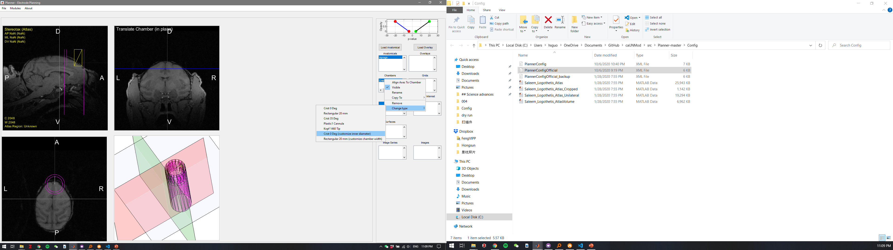
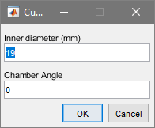
Planner new features (1): customize (circular/rectangular) chamber size

Slide 2
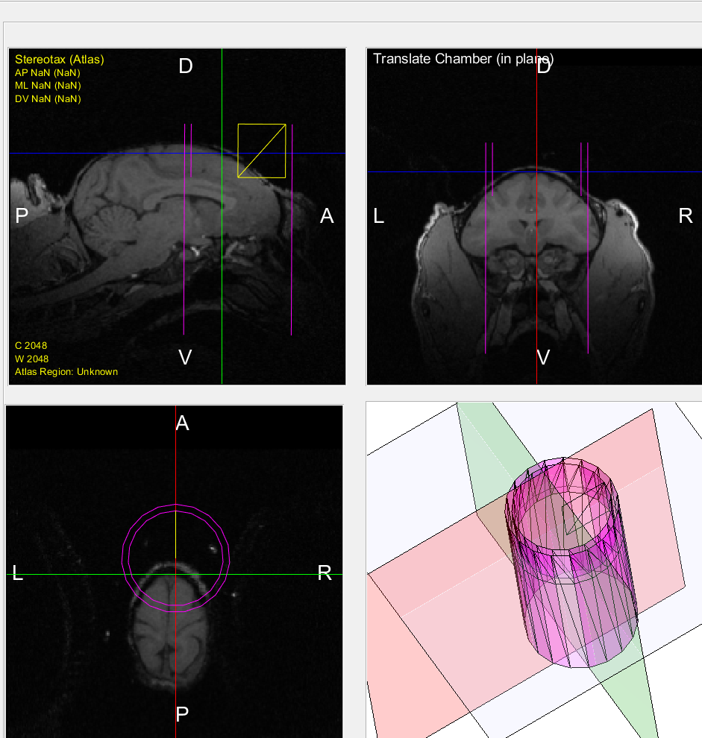
Planner new features (1): customize (circular/rectangular) chamber size
Inner diameter changed to 36 mm

Slide 3

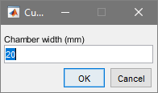
Planner new features (1): customize (circular/rectangular) chamber size

Slide 4
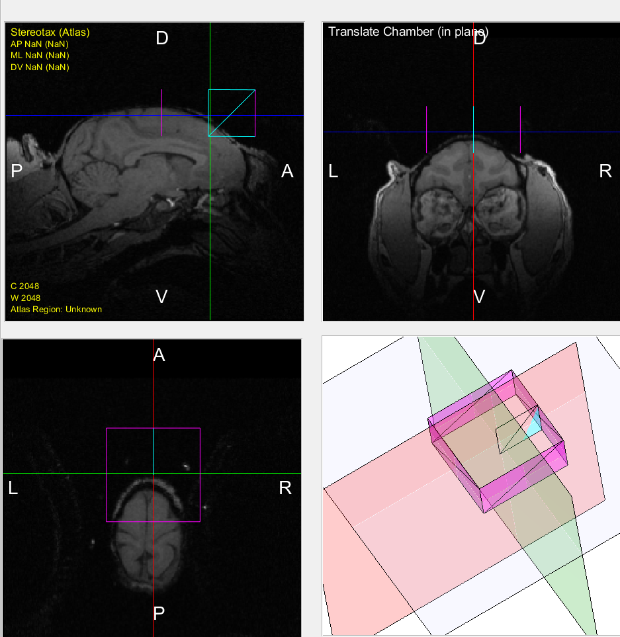
Planner new features (1): customize (circular/rectangular) chamber size
Chamber width
changed to 40 mm

Slide 5
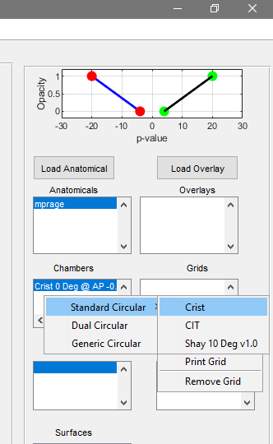
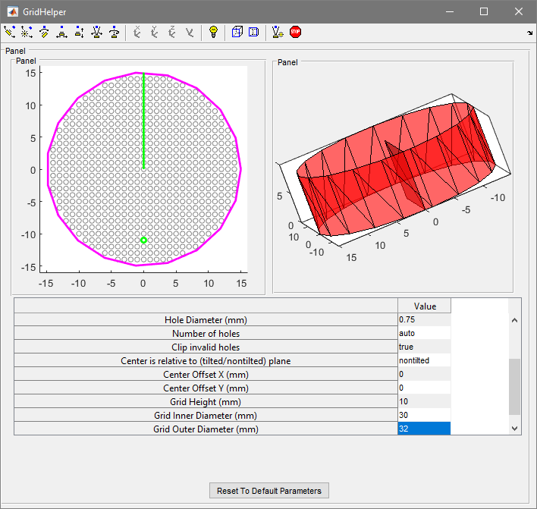
Planner new features (2): customize (circular/rectangular) grid size?

Slide 6
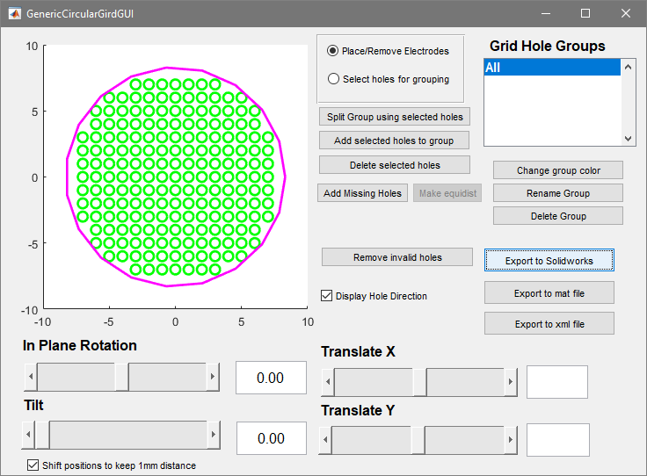
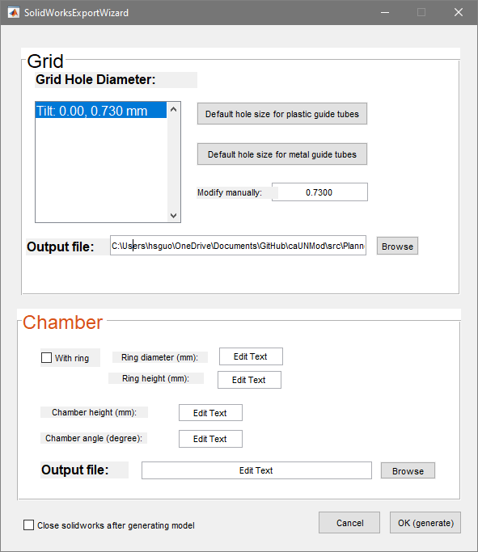
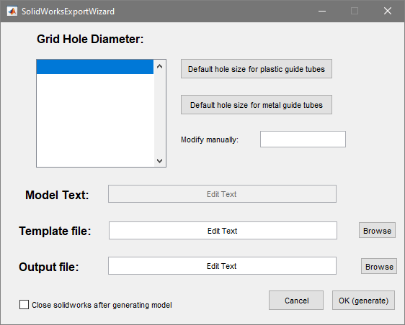
Planner new features (3): export chamber and grid to Solidworks
New design
Current design

Slide 7
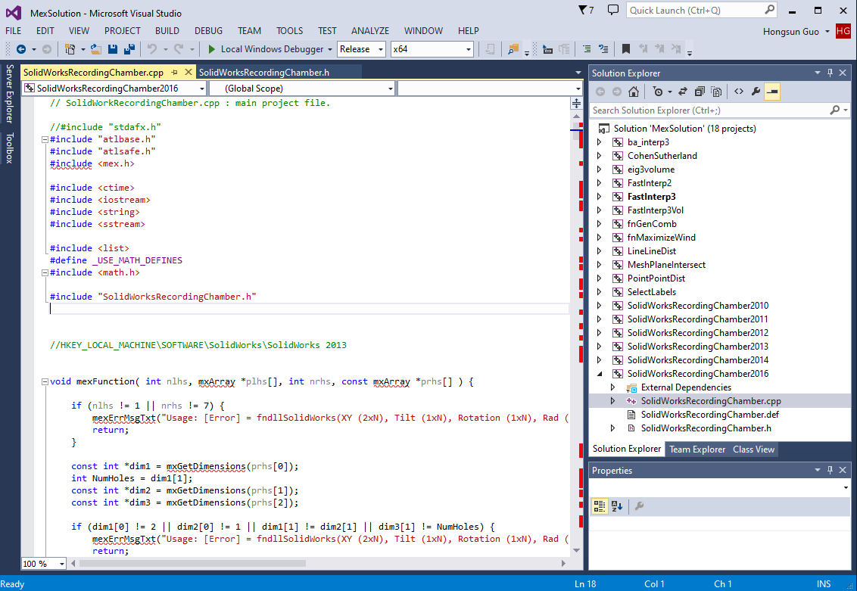
Planner new features (3): export chamber and grid to Solidworks:
Planner-master\MEX_CODE

